Slide 1

FINANCIAL PERFORMANCE ANALYSIS UNDER ESG
INTERNSHIP 2023
-Manasi Bondalapati

Slide 2
Agenda
1.Objectives
2.Introduction
3.Process
4.Data acquired
5.Insights
6.References
7.Appendix

Slide 3
Objectives

Slide 4
TOPICS EXPLORED
01
Exploratory Data Analytics
Learning techniques like scaling, merging, cleaning, handling missing values etc.
02
Power BI
Using Power BI to visualize the data and gaining insights.
03
Python (Inc. Standard DS/ML libraries, Pandas, Numpy, etc)
Using Pandas and other libraries in python to perform various actions on the data .

Slide 5
Introduction

Slide 6
Environmental, Social, and Governance is a set of standards used to assess a company's effectiveness and influence in these three crucial areas.
Environmental –its carbon footprint, energy use, water use, waste management, environmental policy etc.
Social-It involves consumer satisfaction, community involvement, diversity and inclusion, labour practices etc.
Governance-It encompasses accountability, transparency, executive compensation, and commitment to moral principles
ESG ratings make it possible for stakeholders, investors to evaluate a company's adherence to ethical business practices and chances of long-term success.
Positive ESG score can result in improved financial stability, and lower operating expenses.

Slide 7
Process

Slide 8
ACQUIRING THE DATA FROM RELIABLE SOURCES
USING PANDAS AND INSTALLING OTHER LIBRARIES REQUIRED
CLEANING PREPROCESSING THE DATA

Slide 9
SCALING AND FINDING THE CORRELATION OF THE DATA
EXTRACTING INSIGHTS,FINDING THE KPIs
VISUALIZING IN POWER BI

Slide 10
Data Acquired

Slide 11
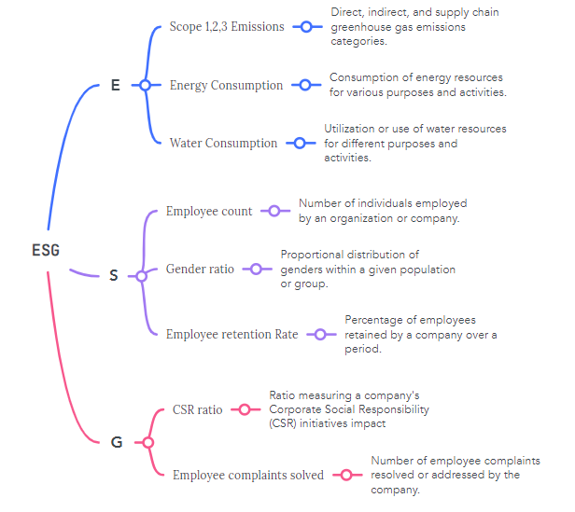
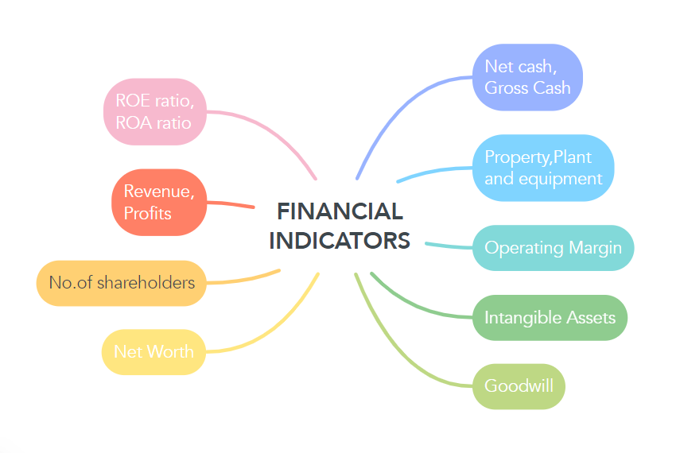
KEY DATA

Slide 12
INSIGHTS

Slide 13
CORRELATION
ESG metrics and few financial indicators are highly correlated while the others are indirectly related.
Important financial parameters like revenue and Operating margins are affected by the ESG scores

Slide 14
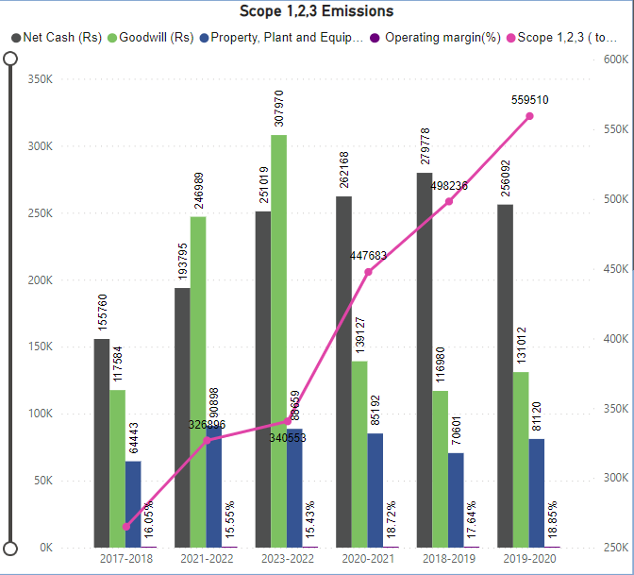
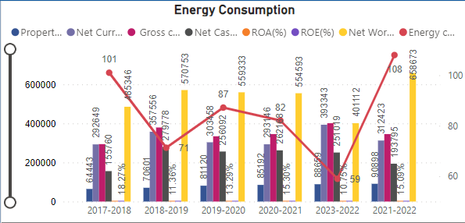
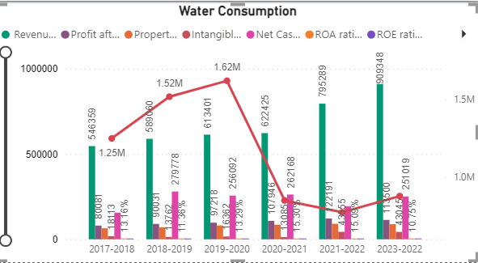
Environmental Metrics

Slide 15
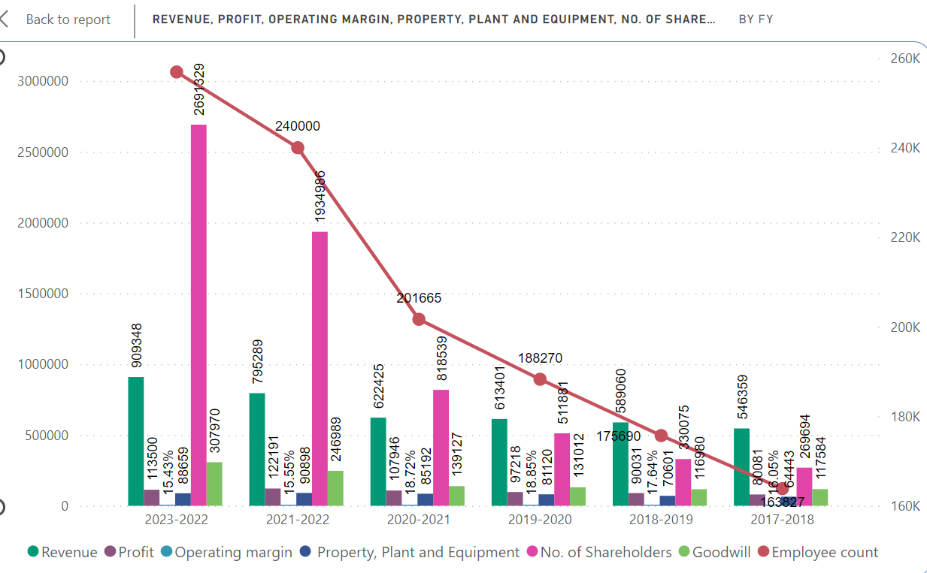
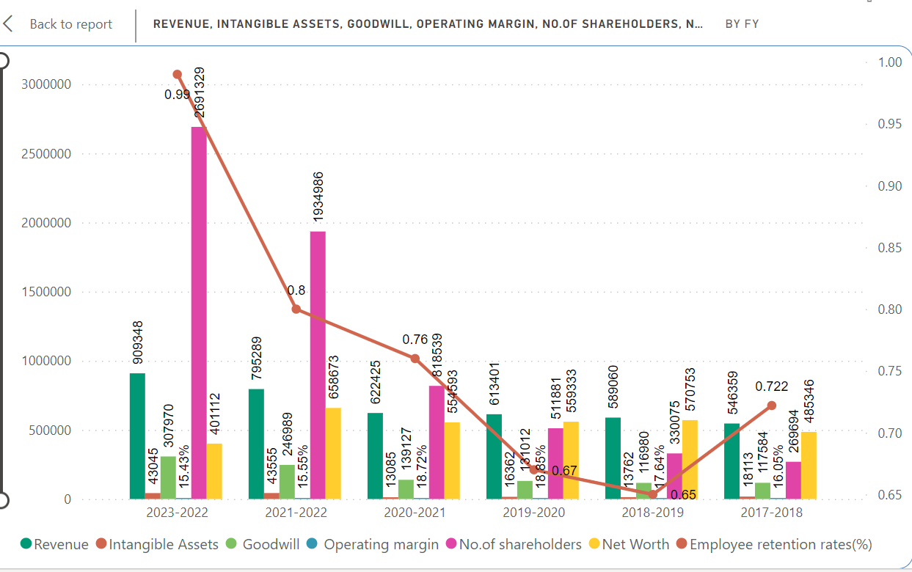
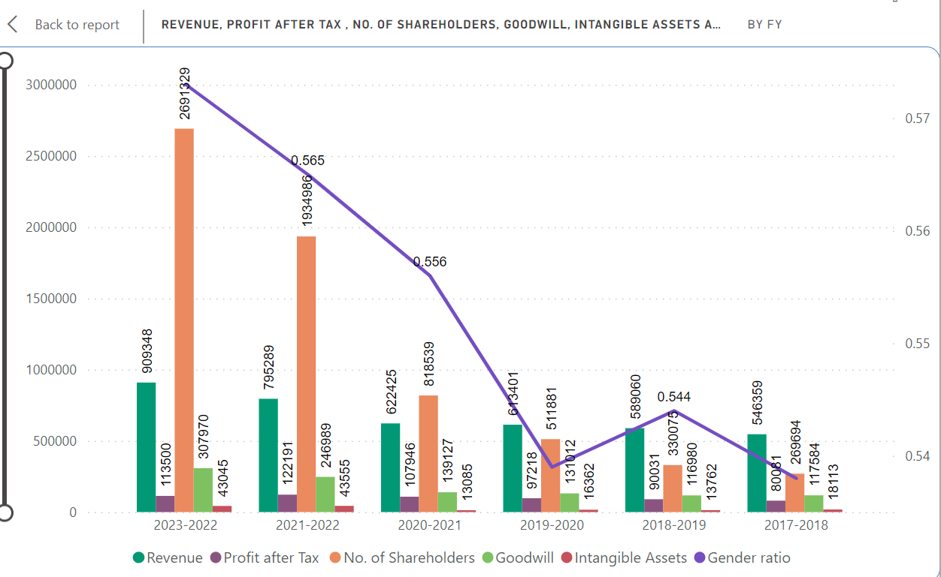
Social Metrics

Slide 16
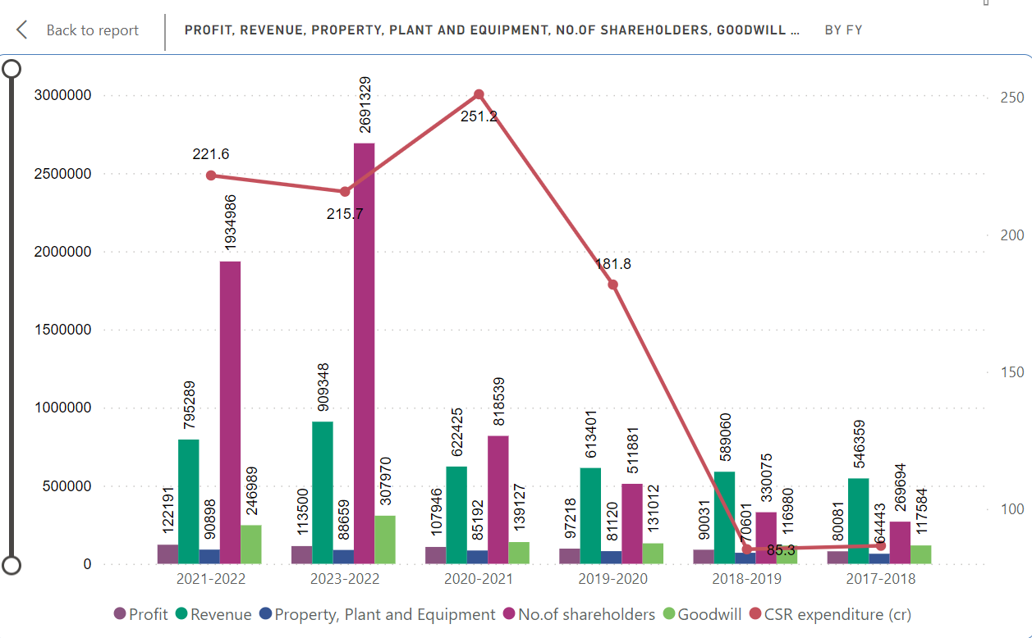
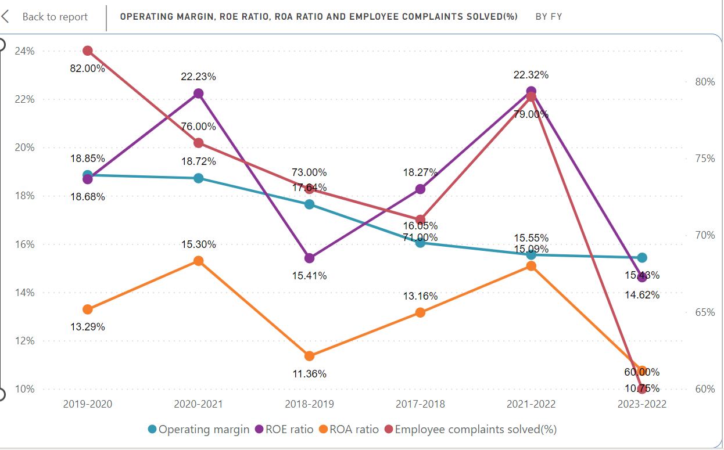
Governance Metrics

Slide 17
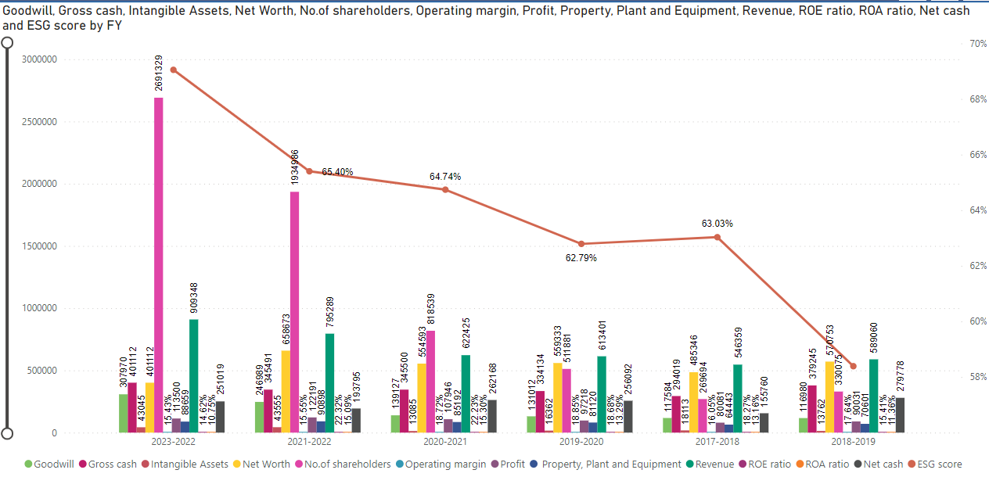
ESG SCORE

Slide 18
References

Slide 19
REFERENCES
Macrotrends web
WIPRO integrated-annual-report-2022-23
WIPRO integrated-annual-report-2021-22
WIPRO integrated-annual-report-2020-21
WIPRO annual-report-for-fy-2019-20
WIPRO annual-report-for-fy-2018-19
WIPRO annual-report-for-fy-2017-18
WIPRO sustainability-report
NYU Stern Paper on ESG
the-importance-of-esg-as-a-key-drive-of-corporate-performance By: Maria Montenegro
Wipro data past years
environment-social-and-governance-criteria
ESG SCORE REPORT 2020-2021

Slide 20
THANK YOU

